Slide 1




A Comprehensive Benchmark for COVID-19 Predictive Modeling
Using Electronic Health Records in Intensive Care:
Choosing the Best Model for COVID-19 Prognosis
Junyi Gao*, Yinghao Zhu*, Wenqing Wang*, Yasha Wang, Wen Tang, and Liantao Ma
Presenter: Junyi Gao
University of Edinburgh
junyii.gao@gmail.com

Slide 2
1
Clinical Background
2
Problem Formulation
Content
Index
3
Experiment Setup
4
Experiment Results
5
Online System

Slide 3



The COVID-19 epidemic overwhelms health service systems
Since January 2020, the whole world has been facing an unprecedented pandemic crisis brought by COVID-19.
  Many patients suffer from life-threatening systemic problems and need to be carefully monitored in ICU.
The exponential growth of patients has brought massive pressure on the health systems tragically.
  A critically-ill COVID patient is nearly twice as likely to die when the intensive care unit (ICU) is operating at more than 75% capacity, research suggests.

Slide 4
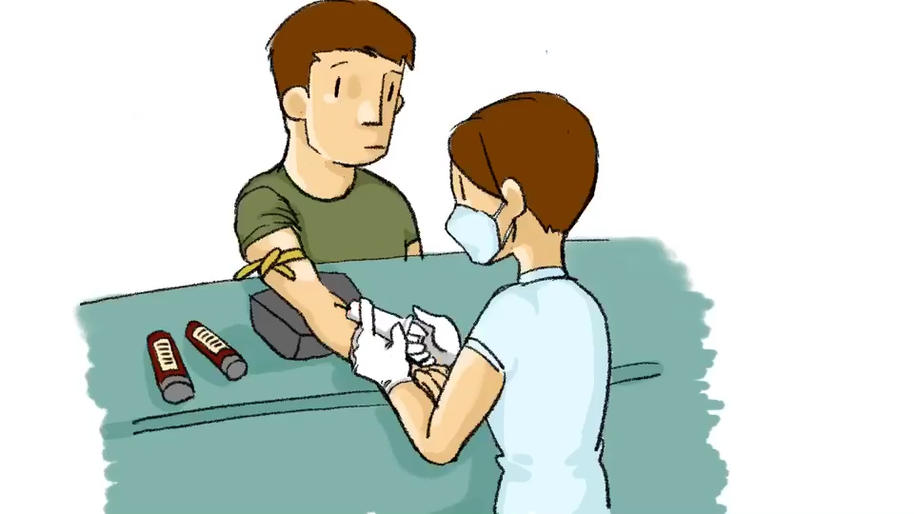
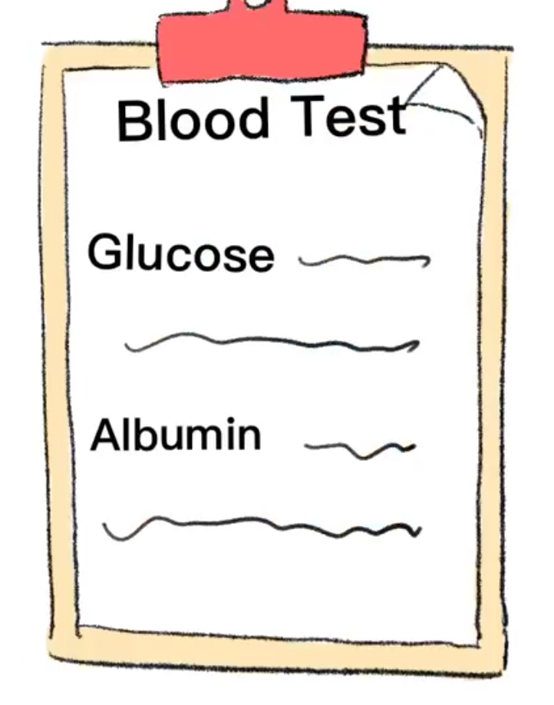
Performing prognosis for critically ill patients
It is crucially essential to perform prognosis for the inpatient
  Input: Vital signs, Laboratory tests, Demographics, etc
  Output: Mortality risk, Length of stay, etc
Feb. 01, 2020
Feb. 02, 2020
Feb. 04, 2020
Feb. 06, 2020
- 4 -
Multivariate time-series electronic medical records

Slide 5












Challenges
How to adapt traditional prediction tasks for COVID-19 patients in intensive care units?
  Early mortality prediction & Outcome specific length-of-stay prediction
  Predict patients’ status at each timestep
How to choose the best model among various options of predictive models?
  Fair comparison for existing ML/DL state-of-the-art models
  Benchmark and online prediction platform

Slide 6







What to predict? 1) Early Mortality Prediction
For ICU patients, for COVID-19 patients in ICU, health statuses may have severely deteriorated and the risks are evident to clinicians at the very last timestep.
  It may be too late to conduct live-saving treatments or procedures with the last-timestep alarm
Traditional method: Only make predictions at the very last timestep
Our approach: predict at every visit

Slide 7








What to predict? 1) Early Mortality Prediction
For ICU patients, for COVID-19 patients in ICU, health statuses may have severely deteriorated and the risks are evident to clinicians at the very last timestep.
  It may be too late to conduct live-saving treatments or procedures with the last-timestep alarm
  Early Mortality Prediction Task: encourages the model to raise alarms for high-risk patients as early as possible to prevent possible treatment delays
Feb. 01, 2020
Admission to ICU
Feb. 15, 2020
Feb. 25, 2020
Mar. 06, 2020
Label: Mortality
Label: Mortality
Label: Mortality
Label: Mortality
Patient A
Adverse Outcome
Mortality
Admission to ICU
Label: Survive
Label: Survive
Label: Survive
Label: Survive
Patient B
Survive &
Discharge

Slide 8
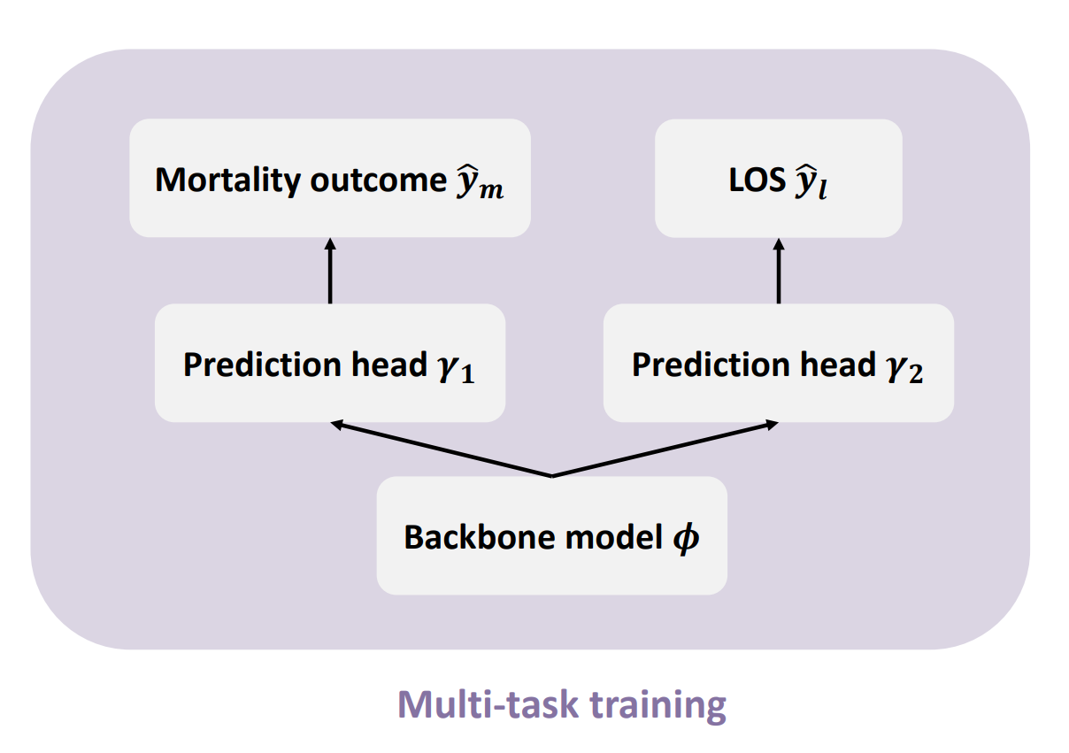
What to predict? 2) Outcome-specific length-of-stay prediction
Outcome-specific Length-of-stay Prediction: multi-target prediction task
  Patients with the same remaining time spent in ICU may have different mortality outcomes.
  Includes a binary outcome classification task and a length-of-stay regression task. → Clinicians can comprehensively evaluate patients’ progression and differentiate the LOS to different outcomes.
Feb. 01, 2020
Admission to ICU
Feb. 15, 2020
Feb. 25, 2020
Mar. 06, 2020
35 days to Mortality
20 days to Mortality
10 days to Mortality
0 day to Mortality
Adverse Outcome
Mortality
Patient A
Admission to ICU
35 days to Discharge
20 days to Discharge
10 days to Discharge
0 days to Discharge
Survive &
Discharge
Patient B

Slide 9
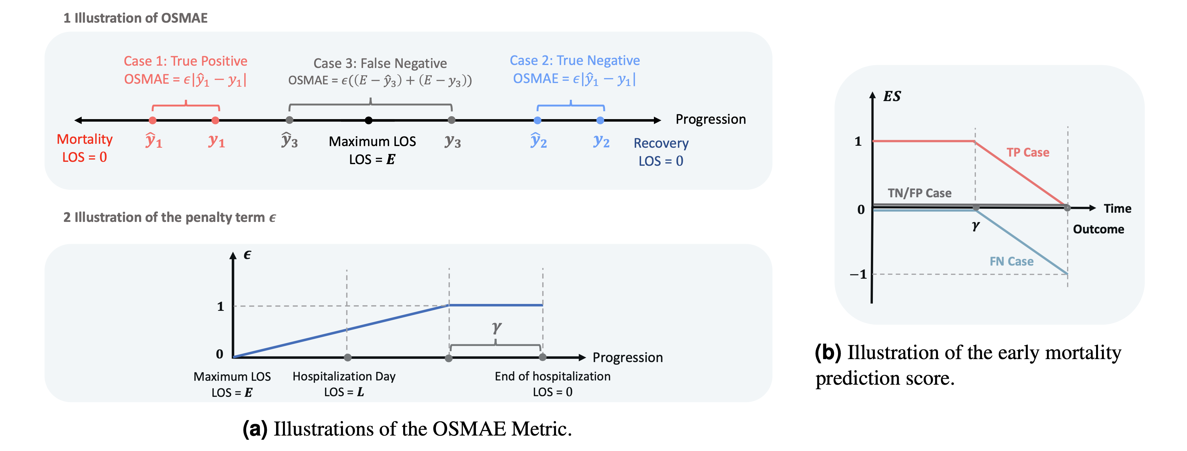
Illustrations of the proposed OSMAE and ES metrics
Take outcome into consideration in Length-of-stay regression task
Encourage the model to predict outcome as early as possible (Focus on positive case)

Slide 10
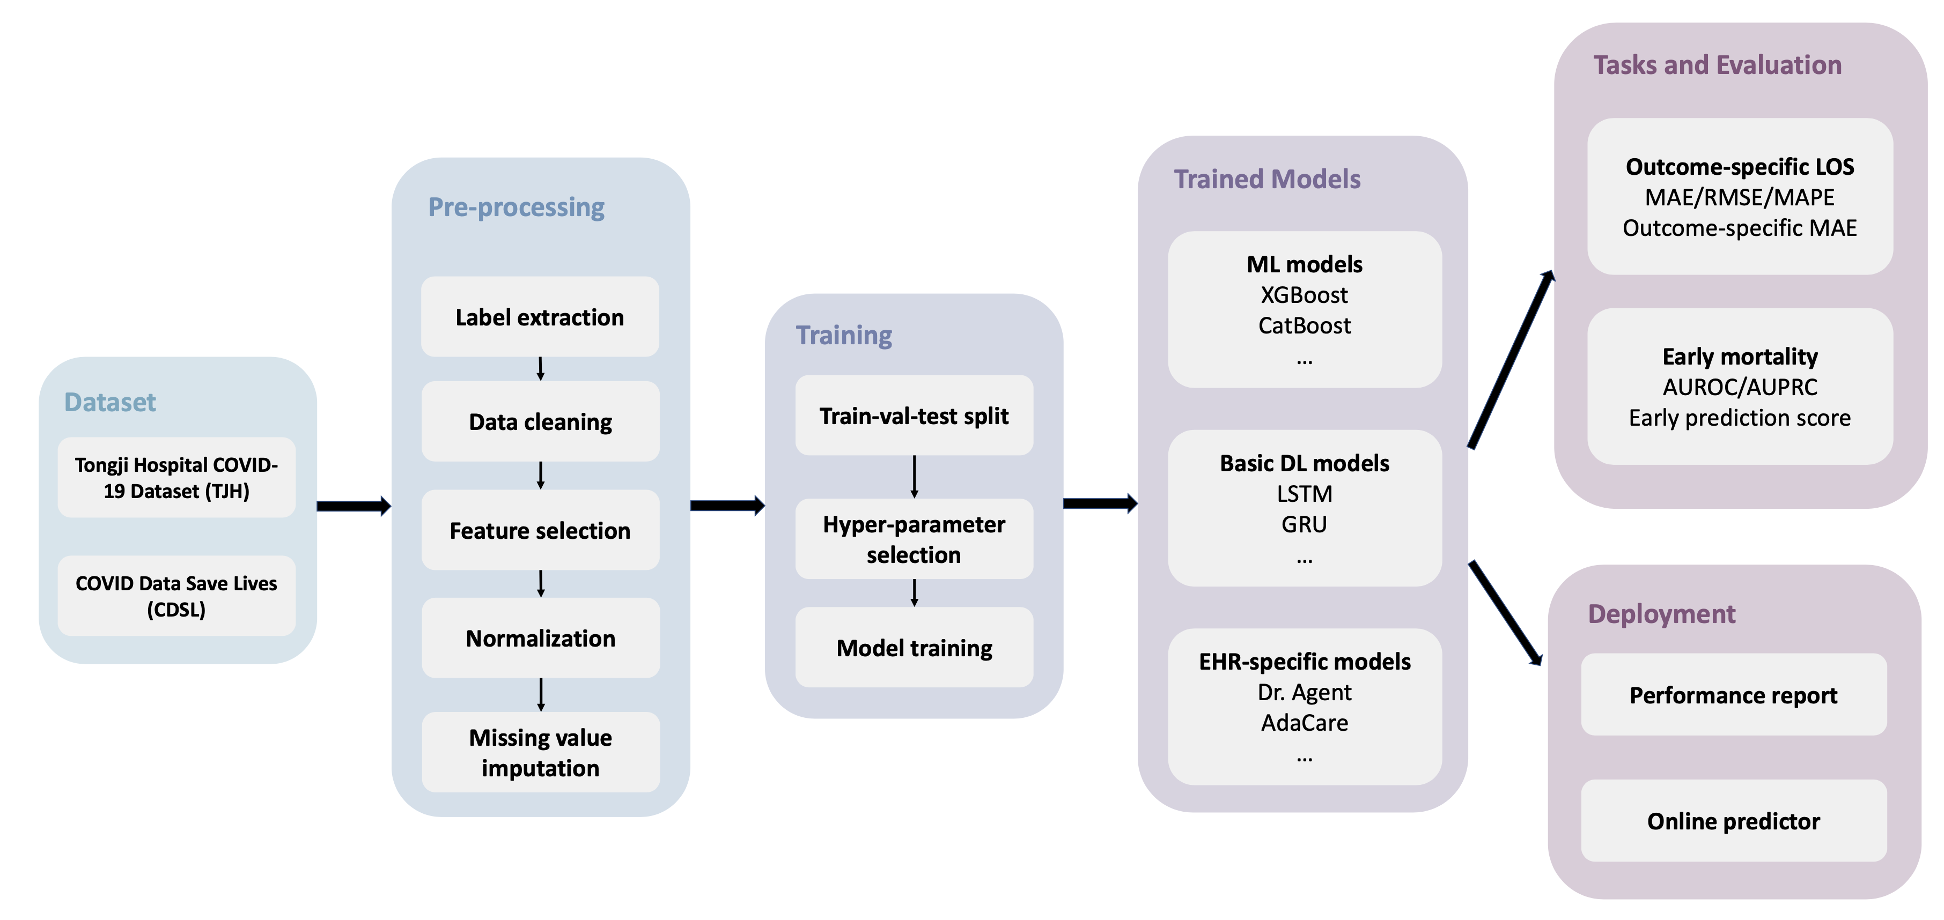
The proposed benchmark pipeline
The pipeline has four steps: Data pre-processing, Model training, Evaluation and Deployment.

Slide 11
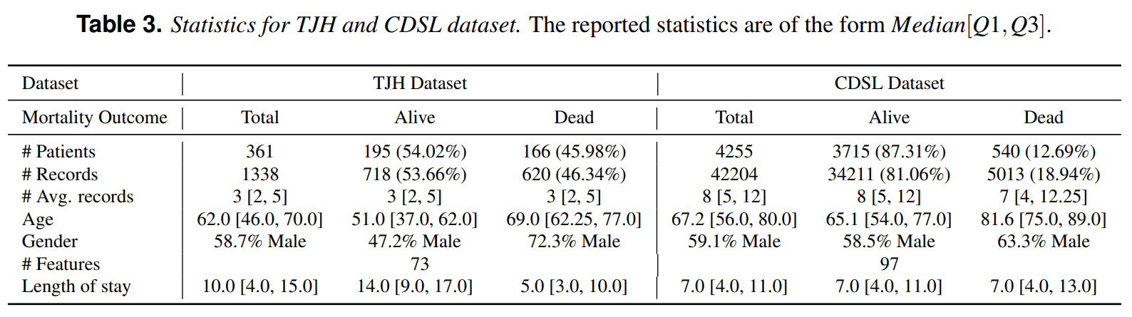
Data pre-processing details of two datasets.
Dataset:
COVID-19 ICU, Tongji Hospital, China (TJH Dataset)
HM Hospitals, Spain (CDSL Dataset)

Slide 12
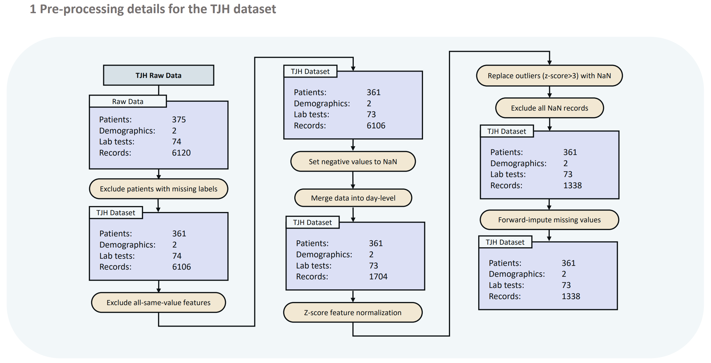
Data pre-processing details for the TJH datasets.

Slide 13
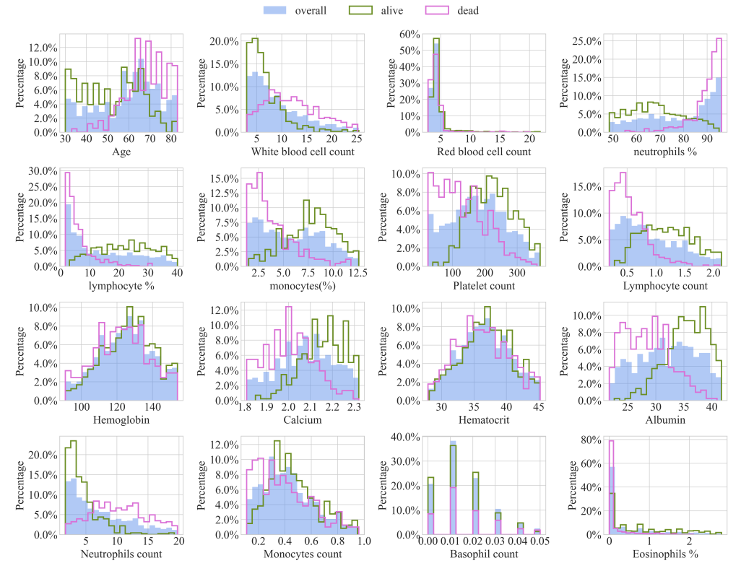
Feature distributions of the TJH dataset
We plot the data distributions of 16 features with the lowest missing rates for the patients.

Slide 14
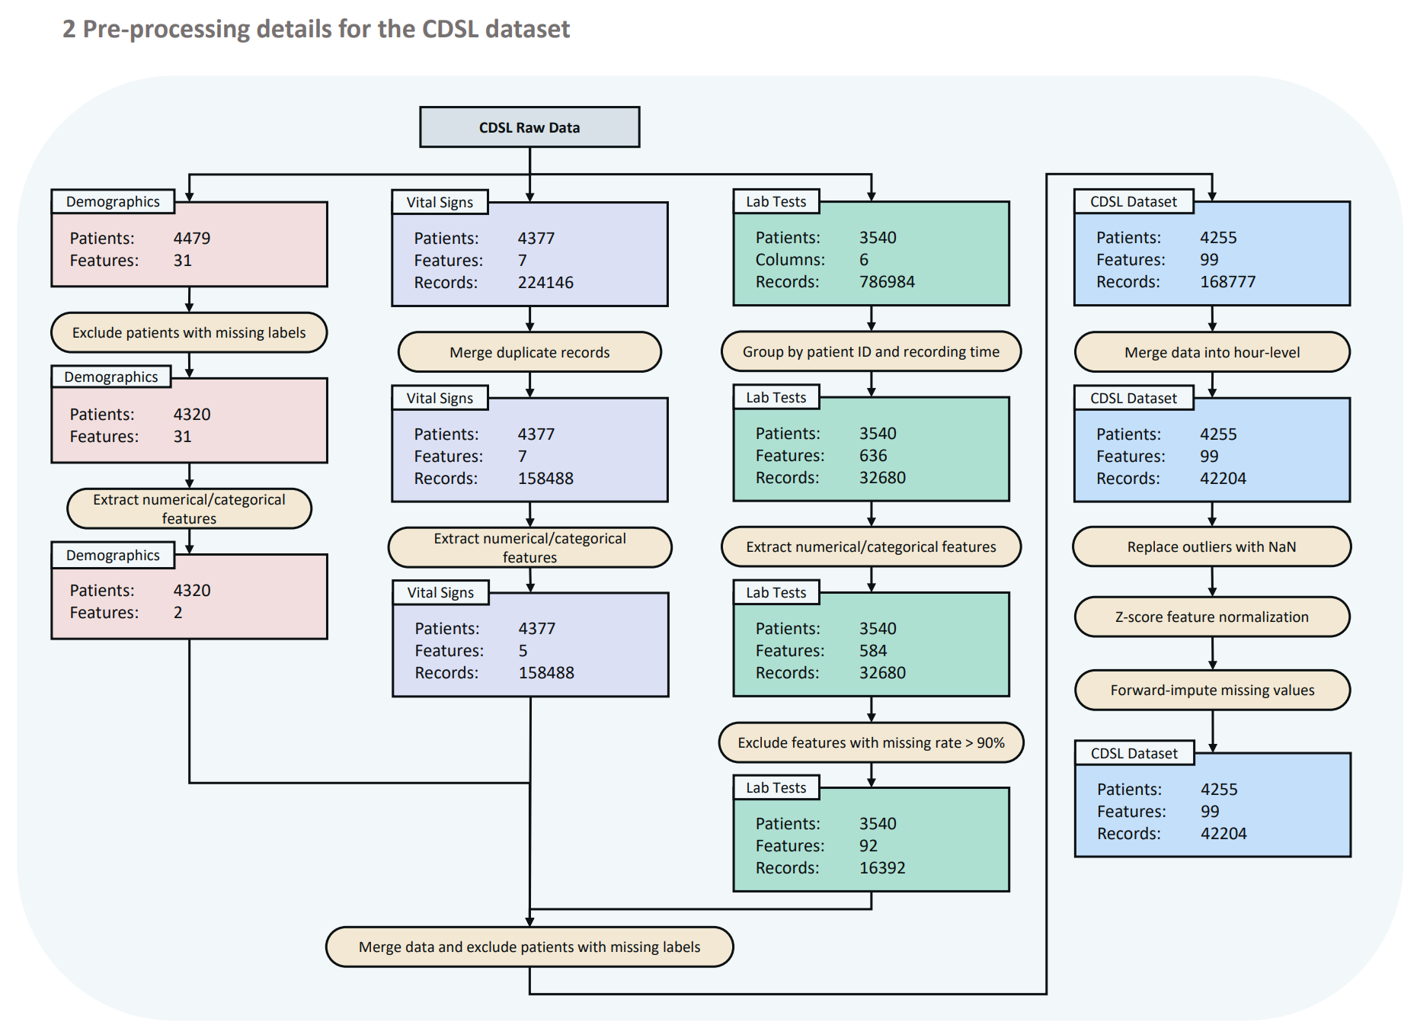
Data pre-processing details for the CDSL datasets

Slide 15
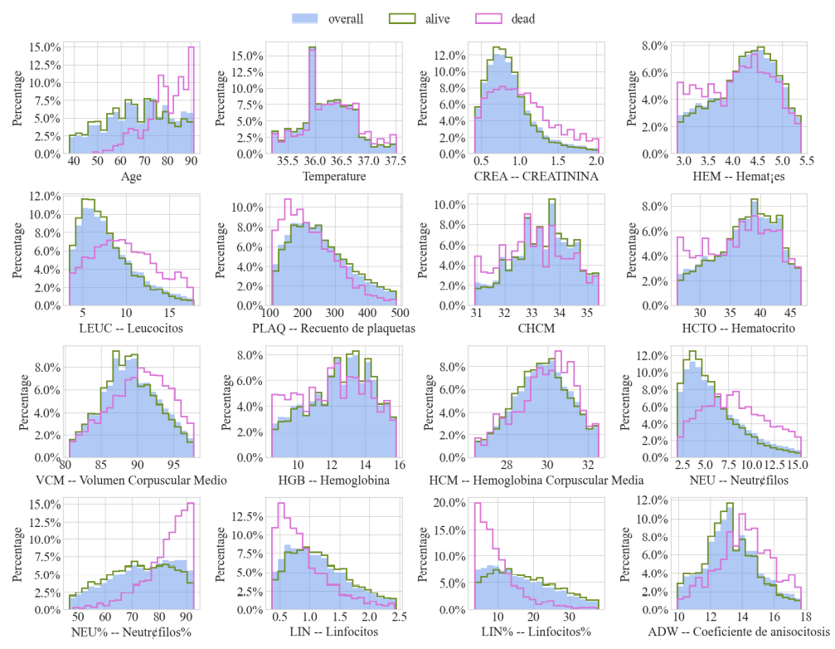
Feature distributions of the CDSL dataset
Similar as TJH Dataset, We plot the data distributions of 16 features with the lowest missing rates for the patients.

Slide 16

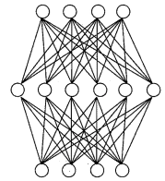



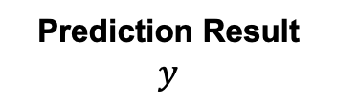
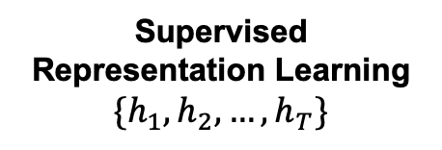

How to Predict? Straightforward solution of deep-learning-based prognosis
Electronic Medic Records
$$\{x_{1},x_{2},…,x_{T}\}$$
Supervised Representation Learning
$$\{h_{1},h_{2},…,h_{T}\}$$
Prediction Result
$$y$$
Similar to NLP
representation learning
    Wear
    a
    medical
    Lab
[0.1, 0.9, 0.3, …, 0.6]
h⁰
RNN
h¹
RNN
h²
RNN
h³
……
RNN
h^{T}
[0.1, 0.9, 0.3, …, 0.6]
[0.4, -0.2, 0.1, …, 0.8]
Time
Stamp
x¹
x²
x³
x^{T}
Patient 1, visit 1
Patient 1, visit 2
Patient 1, visit 3
Patient 1, visit T
[0.1, 0.9, 0.3, …, 0.6]
[0.1, 0.9, 0.3, …, 0.6]
[0.4, -0.2, 0.1, …, 0.8]
[-0.7, 0.3, -0.4, …, 0.1]
[-0.7, 0.3, -0.4, …, 0.1]
Wear
a
medical
lab

Slide 17
Baseline Methods
We propose fair, detailed, open-source data-preprocessing pipelines and evaluate 17 state-of-the-art predictive models on two tasks
5 machine learning models
  RF
  DT
  GBDT
  XGBoost
  Catboost
6 deep learning predictive models specifically designed for EHR data
  Retain
  Stagenet
  AdaCare
  ConCare
  Grasp
6 basic deep learning models
  MLP
  RNN
  LSTM
  GRU
  TCN
  Transformer

Slide 18
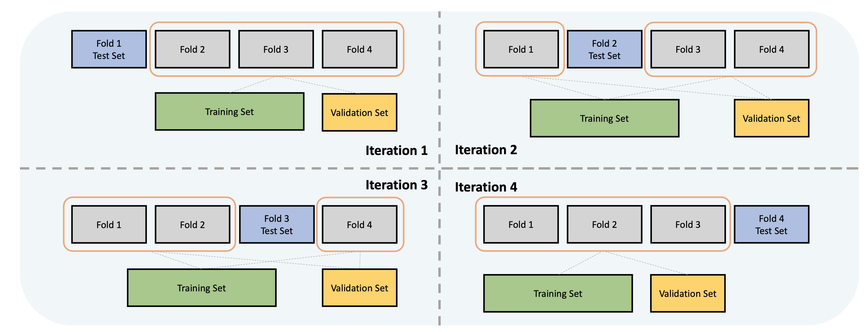
The K-fold cross-validation strategy
To ensure the same distribution in training/validation/test set, We use a stratified shuffle split to ensure the proportions of alive and dead patients on all folds are the same as the total cohort.
(We take 4-fold as an example in the figure)

Slide 19
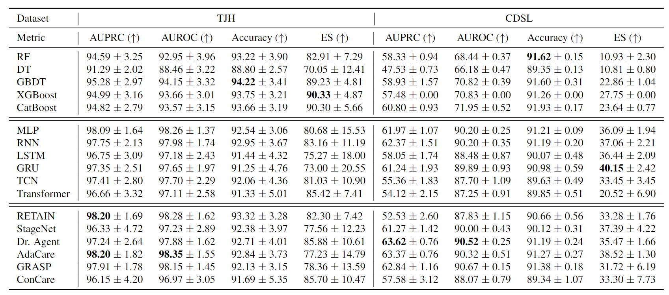
Benchmarking performance of the early mortality prediction task

Slide 20
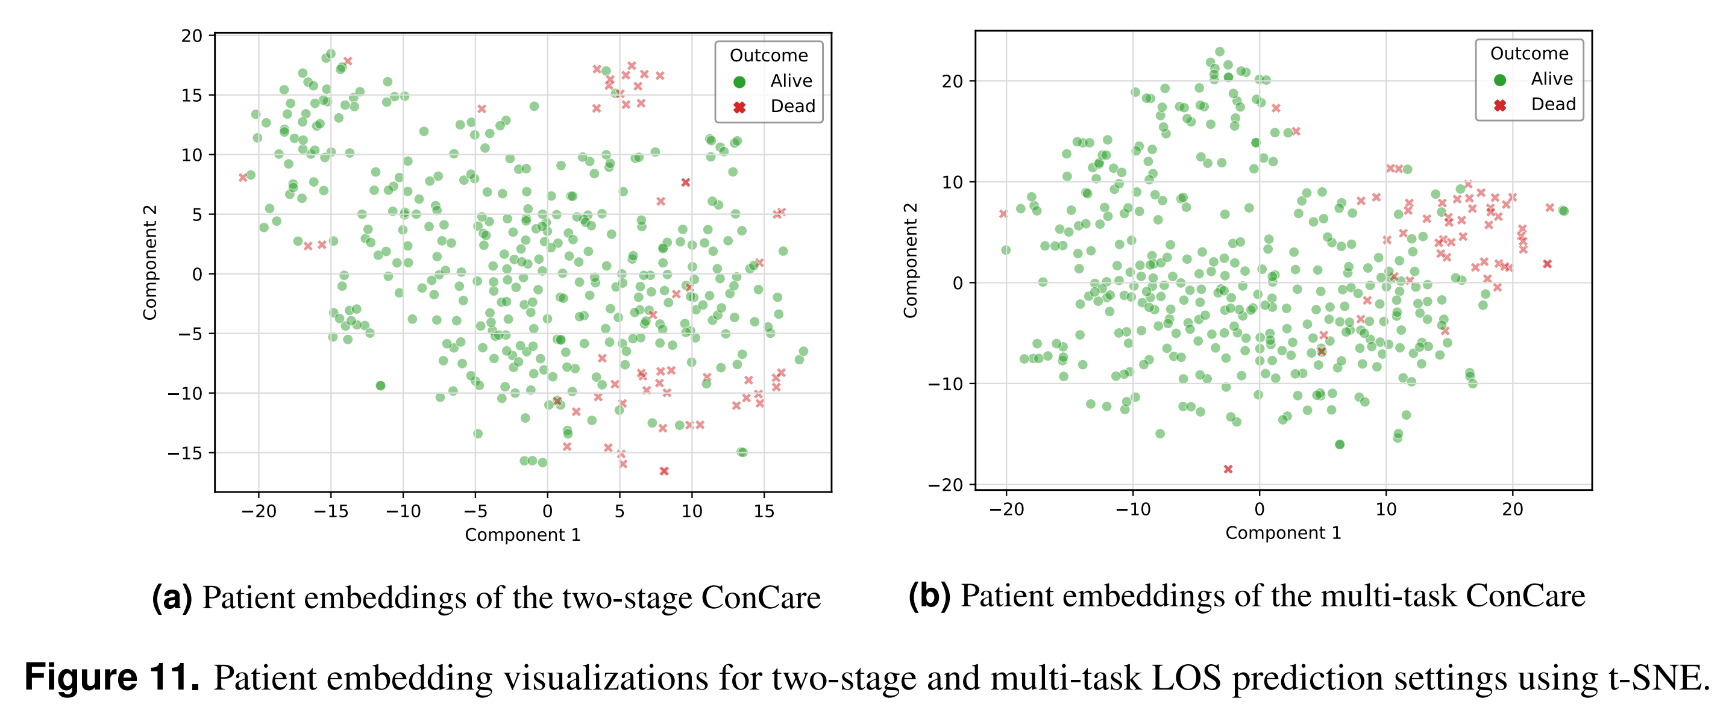
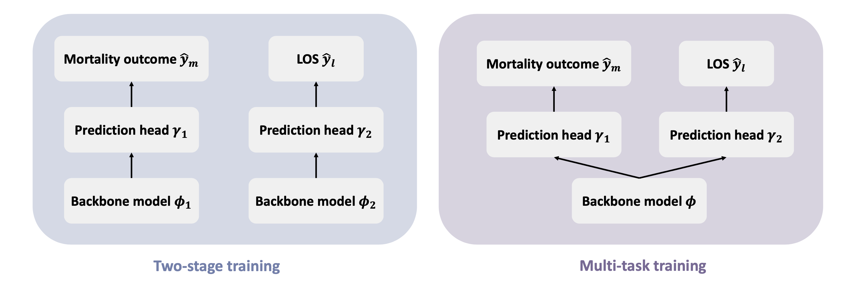
Illustrations of the two-stage training and multi-task training settings
Multi-task training is better:
  End-to-end
  Better representation shown in patient embeddings

Slide 21
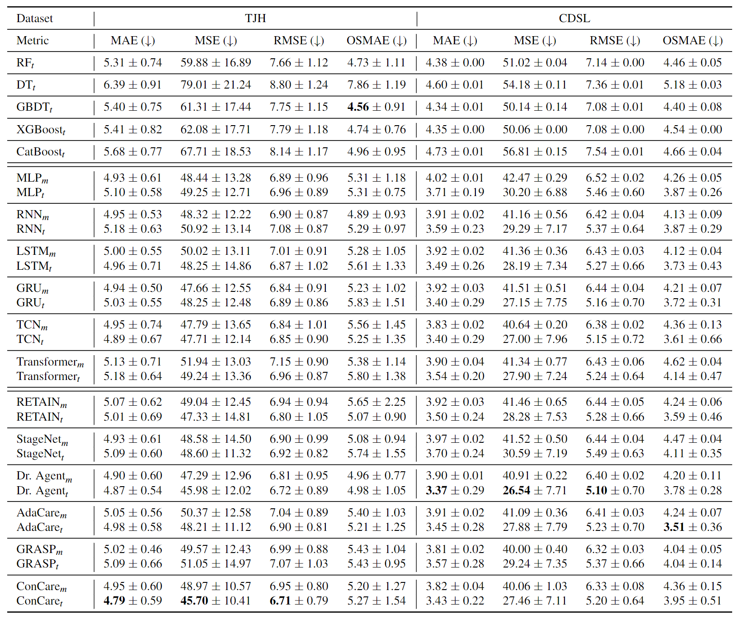
Benchmarking performance of outcome-specific length-of-stay prediction
(Top rows) ML models; (Middle rows) Basic DL models; (Bottom rows) EHR-specific DL models. The reported score is of the form mean±std. Subscript m denotes multi-task learning strategy, t denotes two-stage learning strategy.

Slide 22
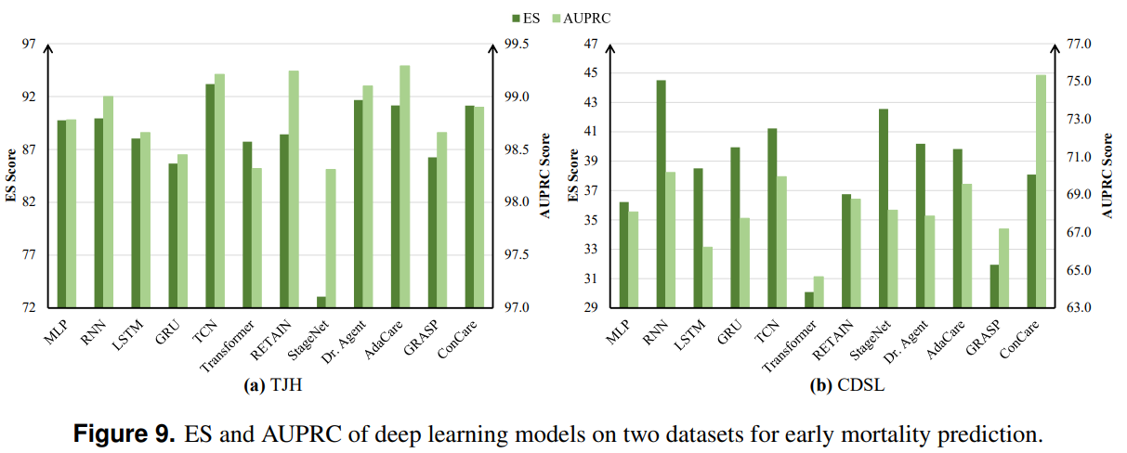
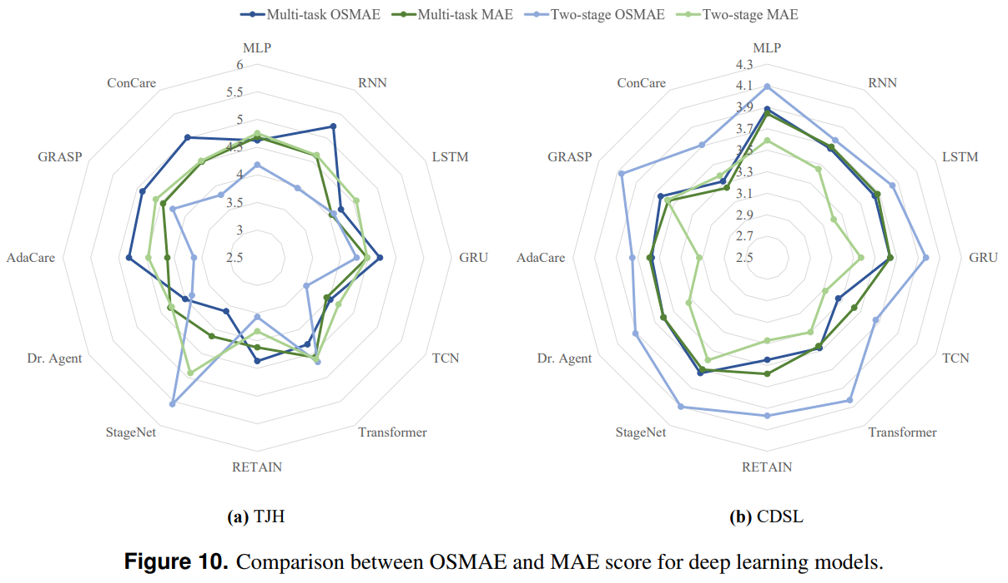
Experiment results in detail
For most models, the performance gaps between AUPRC and ES are not large on both datasets
For the outcome-specific length-of-stay prediction task, the OSMAE and MAE in both multi-task and two-stage settings on two datasets are shown in Figure 10.

Slide 23
Illustrations of the two-stage training and multi-task training settings
Multi-task training is better:
  End-to-end
  Better representation shown in patient embeddings

Slide 24
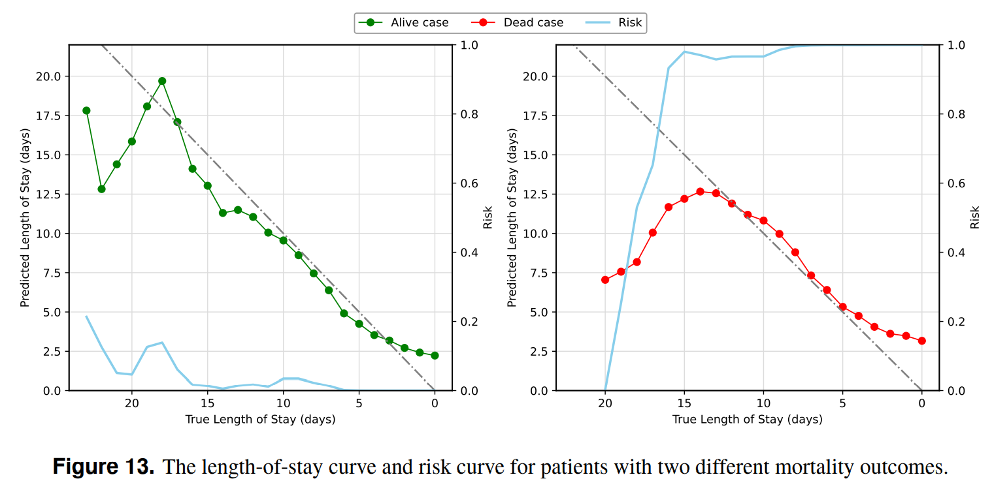
Case Study
Predicting outcome and length-of-stay simultaneously can help clinicians better understand the patient progression

Slide 25
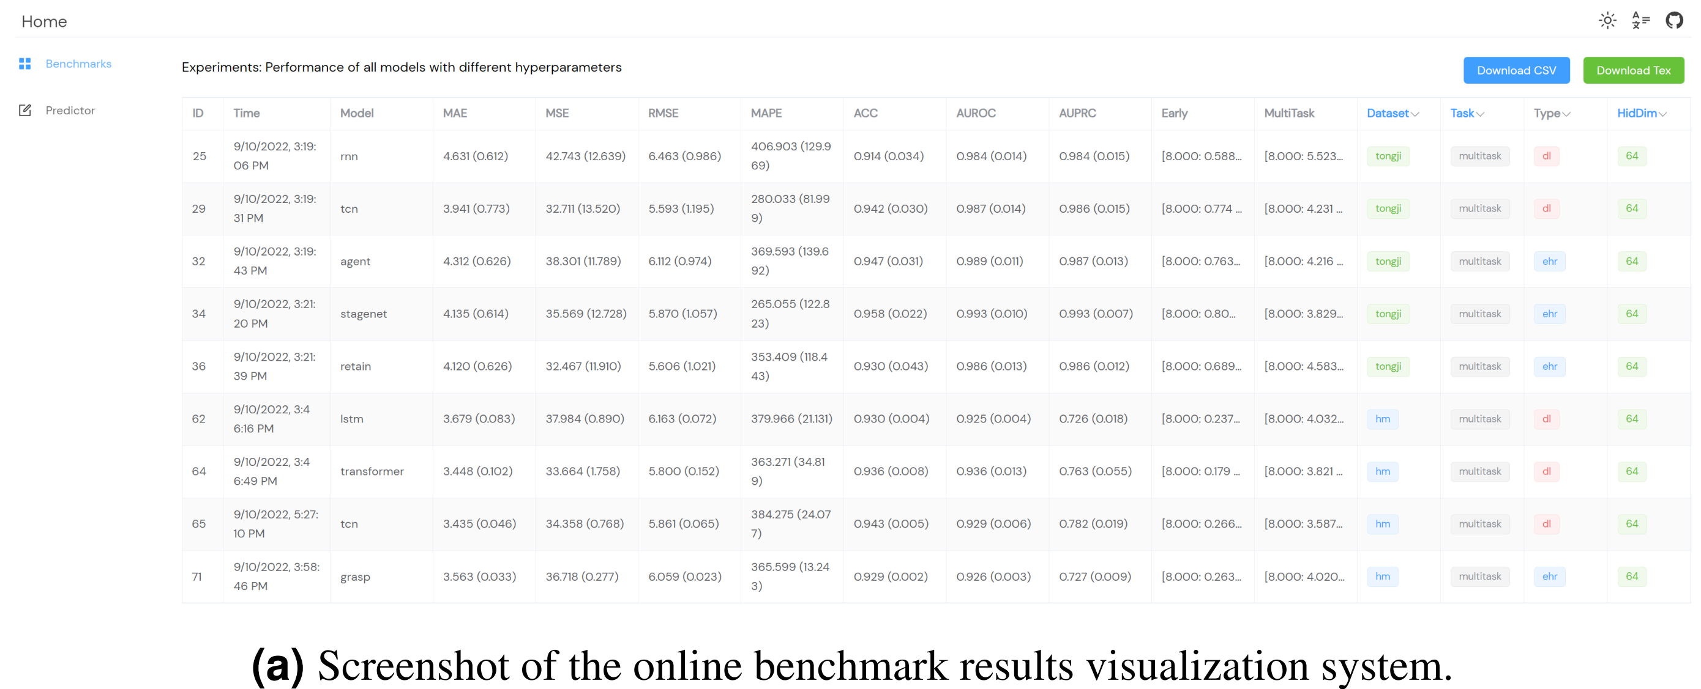
Screenshots of our deployed online benchmark system

Slide 26
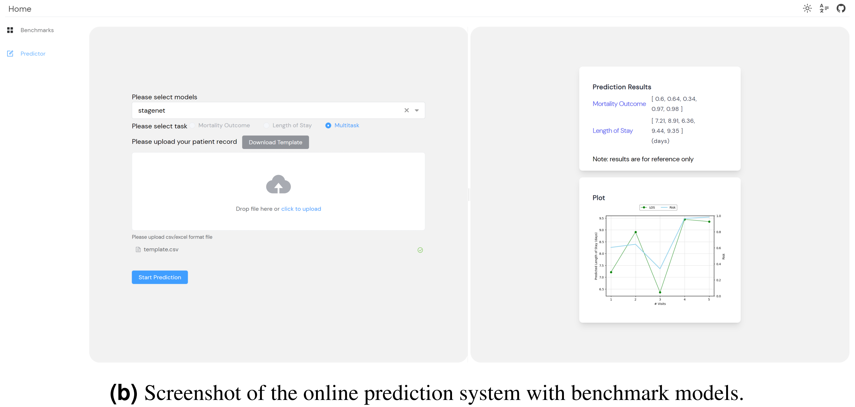
AI-Doctor Interaction System
Peking University

Slide 27

  Thanks for you attention!
Pre-Print https://arxiv.org/abs/2209.07805
Code Repository https://github.com/yhzhu99/covid-ehr-benchmarks
Online Platform http://106.15.42.91:8000/

