Slide 1
MUSEFood: Multi-sensor-based Food Volume Estimation on Smartphones
Junyi Gao, Weihao Tan, Liantao Ma, Yasha Wang, Wen Tang

Slide 2
Diet Recording: An Urgent Need
9.3% Diabetes
12% Obesity
7.8 million deaths annually
Notes:
The worldwide prevalence of diet-related chronic diseases such as obesity (about 12%) and diabetes mellitus (about 9.3%) has reached epidemic proportions over the past decades, resulting in about 2.8 and 5 million deaths annually and numerous co-morbidities. This situation raises the urgent need to develop novel tools and services for continuous, personalized dietary recording for both the general population and those with special nutritional needs such as diabetes and kidney disease patients. Diet recording can help people to maintain a healthy diet and thus improve their health status.

Slide 3
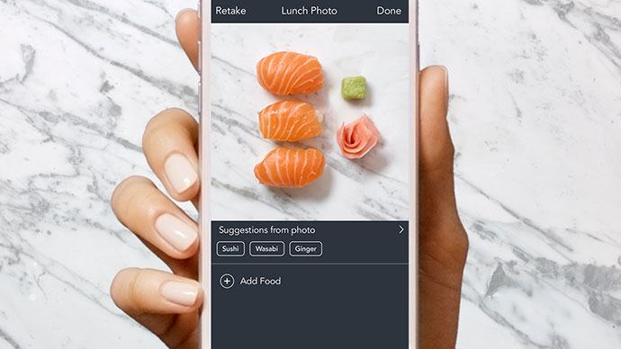
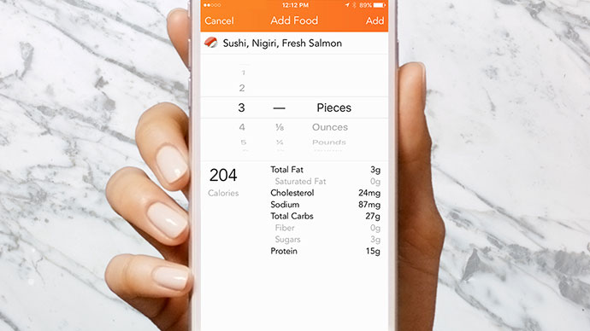
How To Record Your Diet
Step 1: Record what you eat
Many APPs can help you automatically recognize and record your food.
Step 2: Record how much you eat
Mainly rely on human estimation and manually input
20%
Error
Notes:
The first step of diet recording is to record what you eat. Recently, many researchers have proposed a series of methods based on image recognition technology, which can accurately identify the food categories and greatly simplify the manual workload of users.
The next step is to record how much you eat. For this tasks, existing APPs do not provide much support. Users still have to estimate foods’ weight or volume according to their own personal experience and then input data into the APPs manually. This is very inconvenient for users and also inaccurate.
The main reported source of inaccuracies is the error in the estimation of food portion sizes, which averages above 20%. Even well-trained diabetic patients on intensive insulin therapy have difficulties. Therefore it is significant to develop an automatic dietary record method.

Slide 4
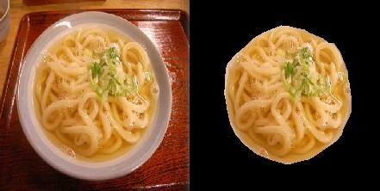
Volume Estimation Is Challenging
Challenge 1: Segmenting the food in the image from the background
Previous works are mainly based on GrabCut and Point Matching
Slow
Require many iterations to segment a single image
Inaccurate
Extract edges based on color contrast, not texture characteristics
Have strict requirements on image quality
Background texture, reflections and even specified shooting angles
Notes:
However, automatically estimating food volume faces two major challenges. The first one is segmenting the food in the image from the background accurately and efficiently. In order to estimate food volume, first we should segment the food item from its background.
Previous food image segmentation methods are mainly based on Grabcut or point matching. These methods are generally slow, because they need iterate several times to segment a single image. And these methods are inaccurate compared to deep learning models, because they use color contrast to extract edges of containers, which means they cannot recognize texture characteristics of foods. Besides, these methods have strict requirements on image capture methods and image quality, for example, background texture, reflections and even specified shooting angles, which pose significant inconvenience and robustness issues in actual use.

Slide 5
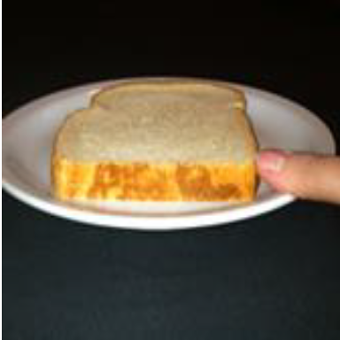
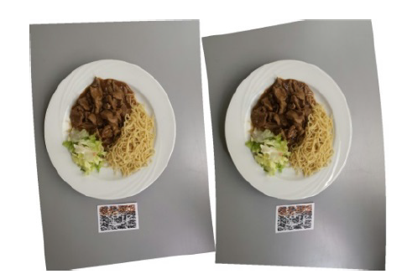
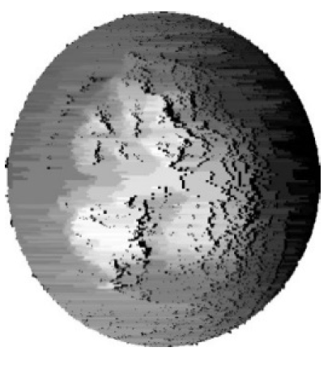
Challenges of Volume Estimation
Challenge 2: Converting the relative size of the food in an image to its actual size
Using a reference object of known size
Inconvenient
Inaccurate
Using special training images
High cost
Limited to specific food
Notes:
The second challenge is to converting the relative size of the food in an image to its actual size. From the image, we can see the relative size of the food comparing to other items such as containers, chopsticks, forks, etc., which are also present in the same image. However, the actual volume of the food cannot be obtained from the image alone.
Some existing works require the user to place some reference objects of known size together with the food into the same photo. However, these methods require the user to always carry the reference objects, which causes inconvenience. And some works use peoples’ finger or chopsticks as reference object. The size of these objects may vary, which cause errors in the final volume estimation.
Some other methods use images with volume information (e.g. depth images taken by special device) to train their models. These methods can only be used for the same type of food as the food in the training set. And because of the high cost of expanding the training set, the scope of their application is quite limited.

Slide 6
Our Solution
MUSEFood
Echo ranging method to calculate the actual volume
Multitask Fully Convolutional Network to segment food items
More accurate
More efficient
More versatile
Food image dataset, SUEC Food
600 manually segmented images
31395 segmented images by GrabCut method
Notes:
To tackle these challenges, we propose a Multi-Sensor-based Food volume estimation method on smartphones, MUSEFood. MUSEFood collects data from multiple sensors on smartphones, it use echo ranging method instead of reference object to calculate actual volume. And it uses multitask fully convolutional network to segment food items.
MUSEFood is more accurate, efficient and versatile compared to SOTA methods.
Along with this paper, we also release the food image dataset, SUEC Food, which contains 600 segmented food images annotated manually and over 30000 images annotated using Grabcut method.

Slide 7
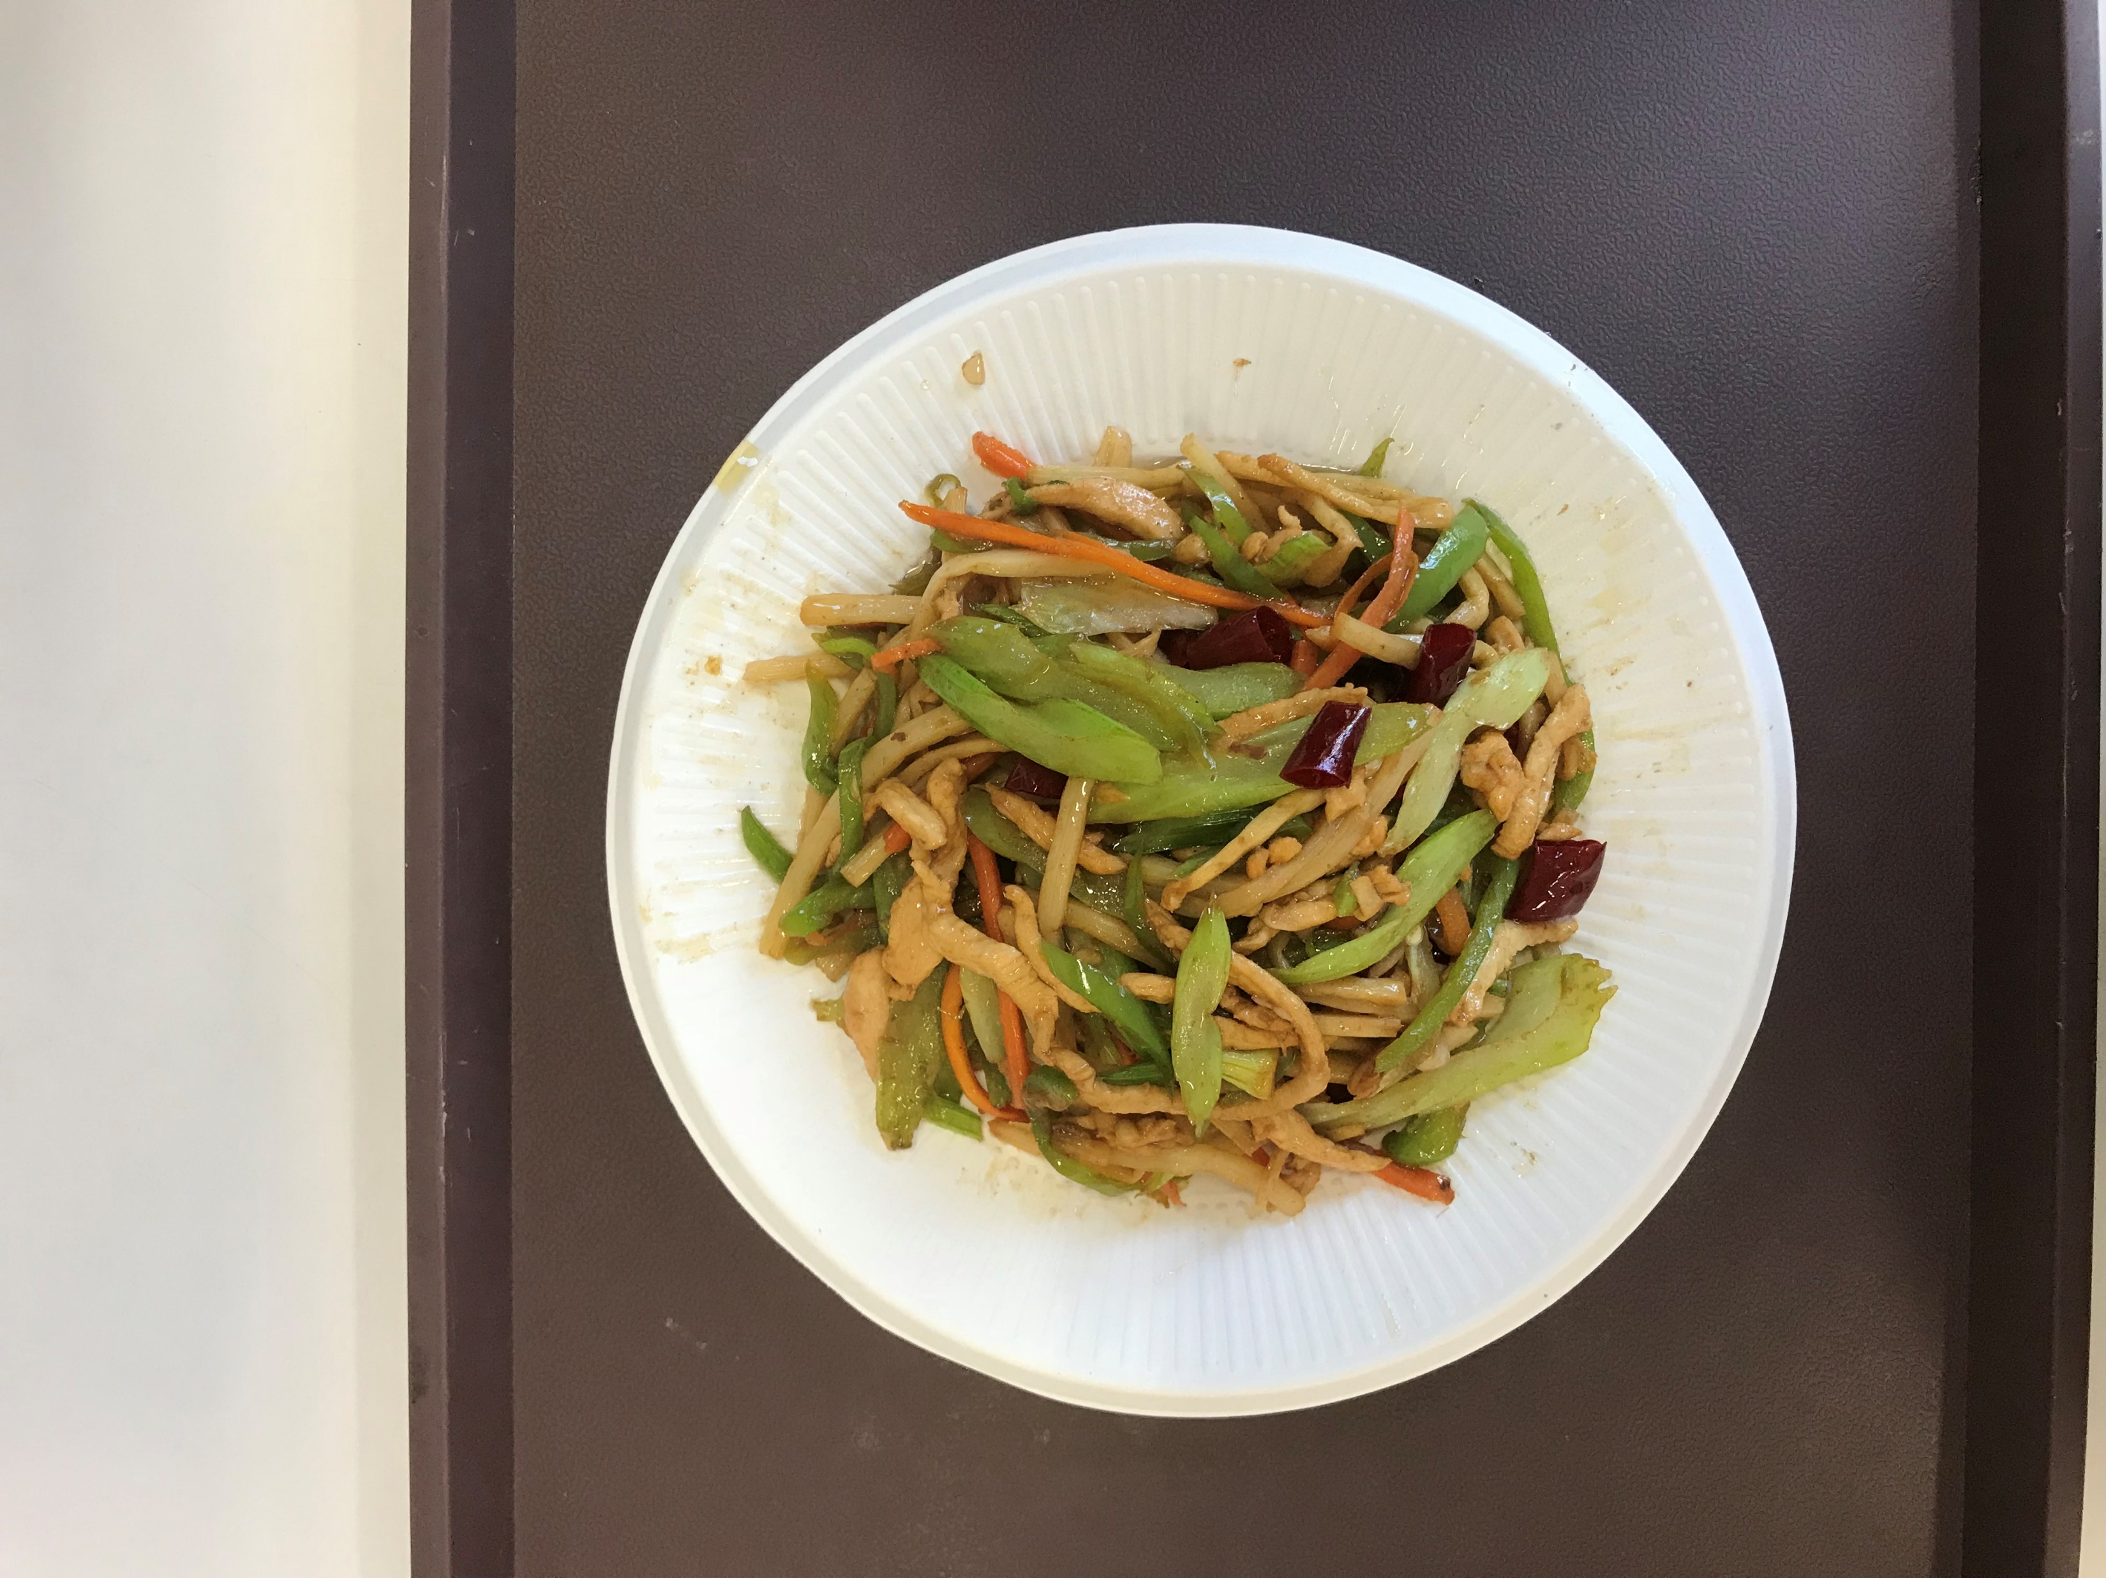
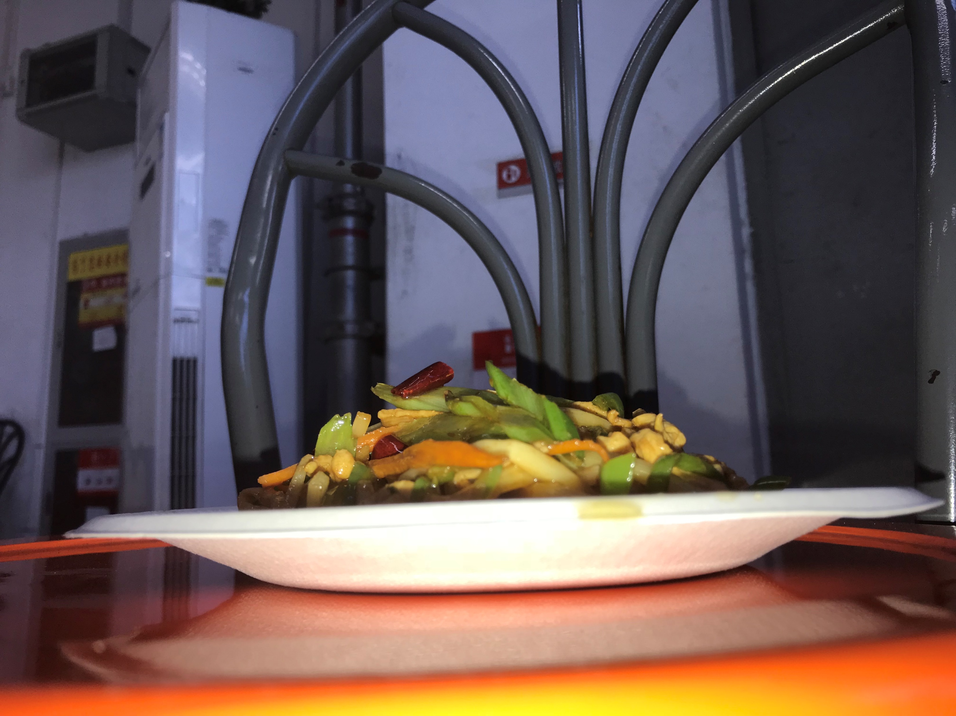
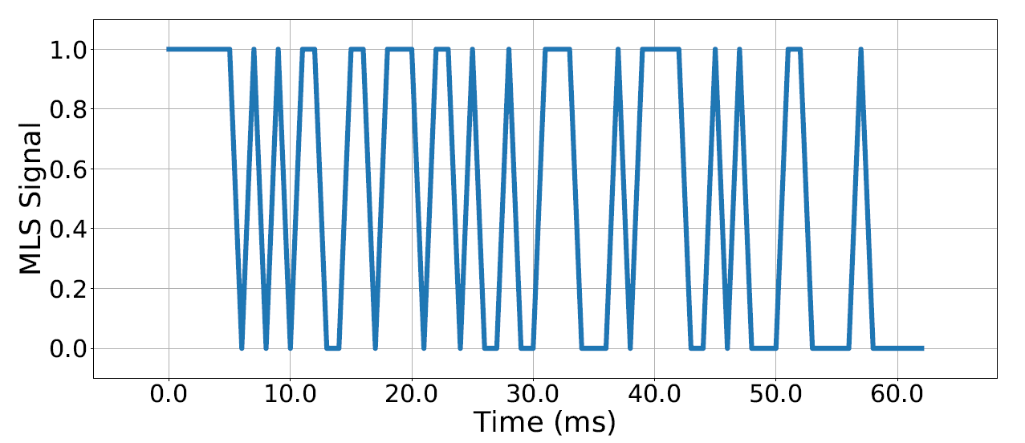
Ⅰ. Sensing
Image sensing
Audio Sensing
While taking the top-down photo, the speaker emits a Maximum Length Sequence audio signal.
Meanwhile, the microphone begins recording.
1. A top-down photo
2. A side photo
Notes:
To estimate food volume, the first step is sensing. First, the user needs to take a top-down photo and a side photo of the food.
While the user is taking the top-down photo, the speaker emits a Maximum Length Sequence audio signal and the microphone will begin recording. The MLS is a pseudorandom binary sequence composed of a sequence of 1 and 0. The MLS has higher computational efficiency and noise immunity compared with other audio signals.

Slide 8
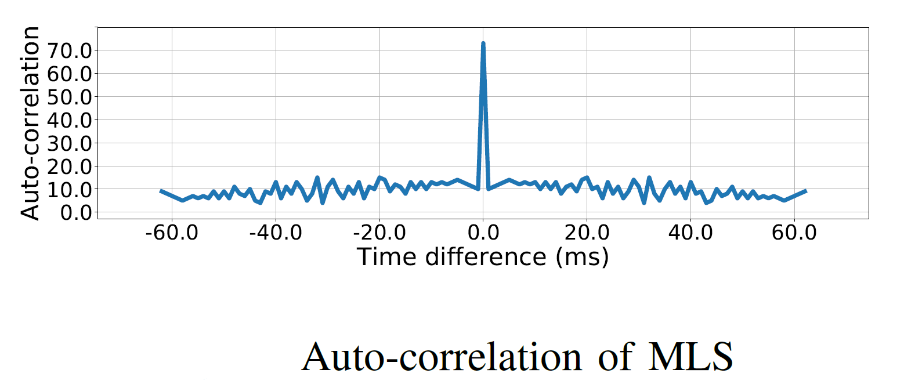
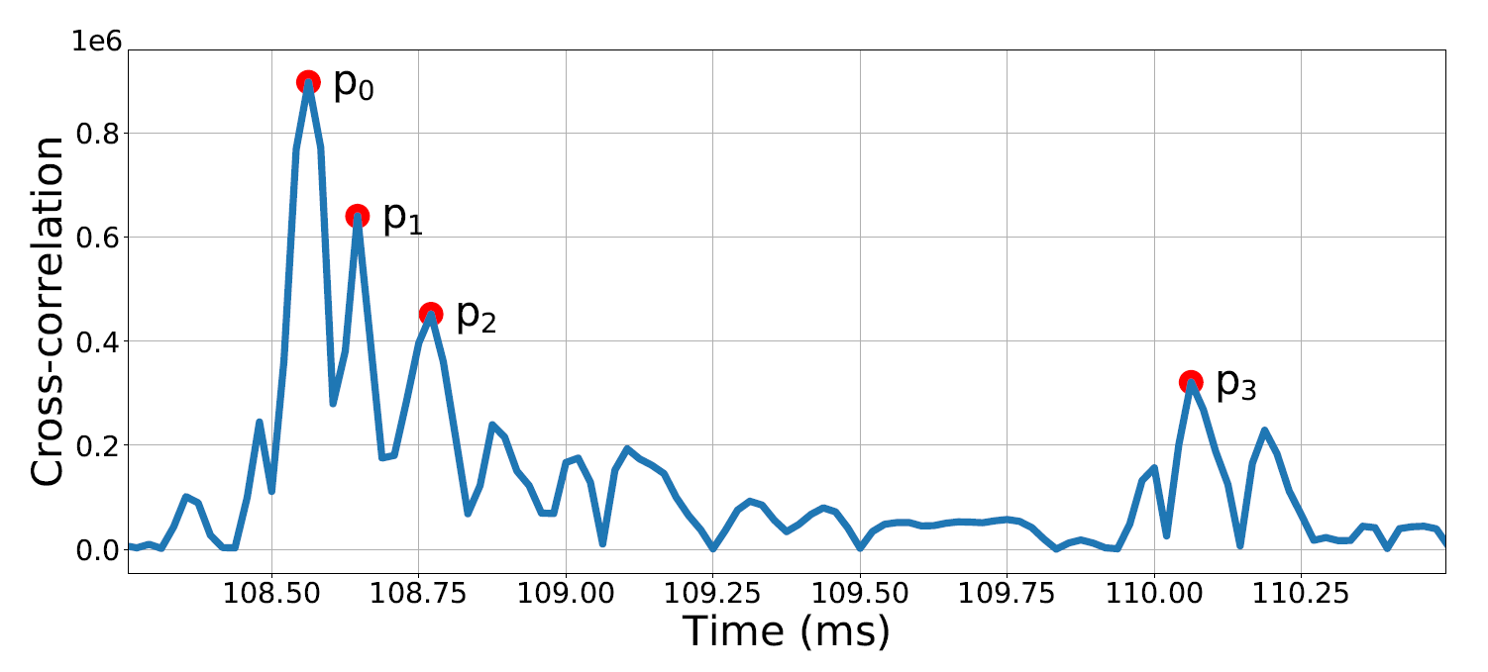
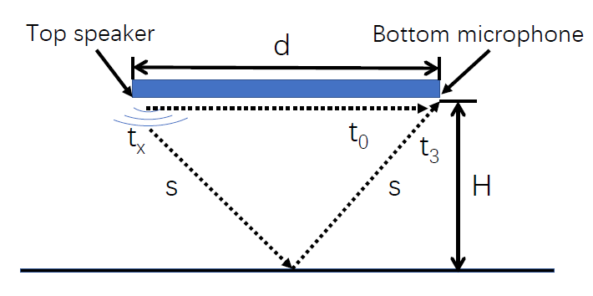
II. Audio Signal Processing
Vertical distance measurement
Calculate the cross-correlation of the original MLS signal and the recorded signal.
Calculate the distance from the phone to the desktop H by the Pythagorean theorem.
Original signal
Obstacles reflection
Desktop reflection
Notes:
In order to get the vertical distance from the phone to the desktop, we compute the cross-correlation of the original MLS signal and the recorded signal.
The auto correlation of MLS is an impulse function.
Since the recorded audio signal contains the original MLS signal and the audio signal reflected by obstacles, there are multiple peaks in the cross-correlation results, as shown in the figure.
P0 is the time when the original signal was recorded
p1 and p2 represents obstacles reflection.
P3 is the time when the signal reflected by desktop was recorded. According to the time at p0 and p3, we can calculate the distance from the phone to the desktop H by the Pythagorean theorem. Later we will use this distance to calculate the actual size of foods.

Slide 9
II. Image Processing
Food items segmentation
The shape of food items are related to the type of containers.
Three FCN-based multi-task models
Jointly learn the food segmentation and container classification task.
The degree of coupling between two tasks is different.
Food in a bowl
Regular edge
Food in a plate
Irregular edge
Decouple
Decouple
Notes:
In order to segment food items efficiently and accuately, we use deep learning based model to segment food images.
Considering that the appearance of food in different containers may vary, sharing shape information of containers (e.g. bowls or plates) during the segmentation process may increase the accuracy of segmentation.
We propose three FCN based multi-task learning architectures. Both tasks influence each other through updating the shared intermediate layers.
For different models, the degree of coupling between the two tasks is different. In our experiment, MFCN-B has the best performance.

Slide 10
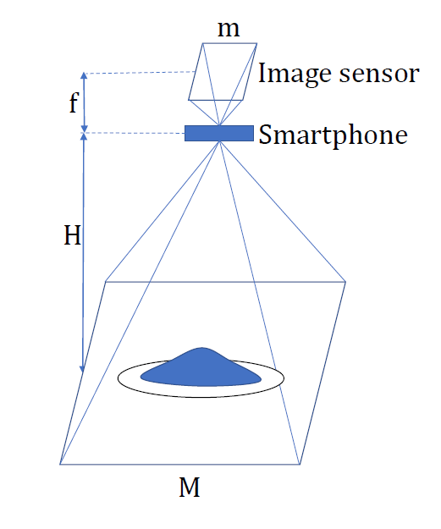
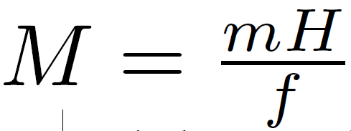
III. Data Aggregation
Actual size scaling
f：The focal length of the smartphone lens
m: The width of the smartphone image sensor
H: The vertical distance from the phone to the desktop
We can get the actual size of the image and the food:
Notes:
To get the actual size of the food in the image, we need to know the actual size corresponding to each pixel in the image. As shown in figure, according to the principle of scaling. f is the focal length of the smartphone lens, m is the width of the smartphone image sensor. For a certain smartphone, both f and m are fixed values.
Then the actual width of the image photoed at the vertical height H can be calculated as the formula. The actual size of segmented food items in two images can be calculated by simply calculate how many pixels the food item has.

Slide 11
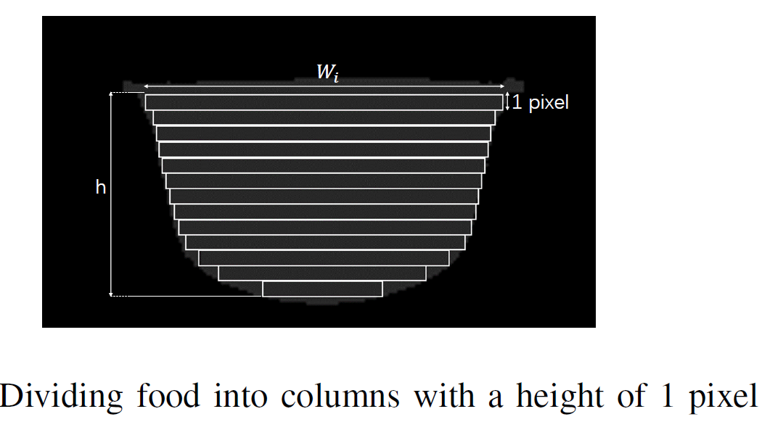
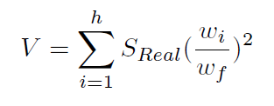
III. Data Aggregation
Food modeling and volume calculating
From two segmented photos we can get the contours of food items.
Food volume is modeled and calculated based on differential model.
Actual size of food items in the top view
Width of the segmented food item in the top view
Notes:
After obtaining the actual food size in the top view image, we calculate food volume using the side view of the food based on a differential model.
As shown in Figure, the food model can be regarded as the accumulation of columns with a height of 1 pixel, and the cross-sectional shape of each column is the shape of the food in the top view image.
Assuming that the width of the segmented food item in the top view is wf , the calculated actual size of food items in the top view is SReal, the number of columns is h, and the width of the crosssection of the column i is wi. Then we can estimate the real volume of the food.

Slide 12
Evaluation
MLS echo ranging
Accurate
Stable
Repeat the MLS signal every 50ms until the correct distance is obtained
The time spent in this process is the longest retry time.
Notes:
In our experiment, we first evaluate our MLS echo ranging method. The MLS ranging method is highly accurate at different distances.
This method is also robust under varying degrees of noise. As shown in the table, even in a noisy cafeteria, it only takes less than 100 ms to get the actual distance.

Slide 13
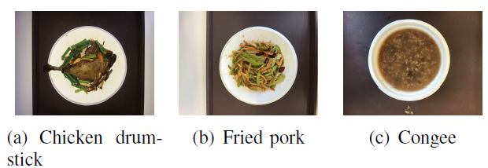
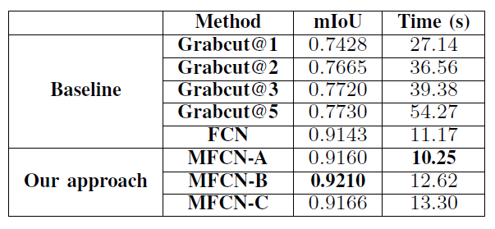
Evaluation
Volume estimation
Significantly faster
Takes about 10 seconds to segment 100 images
The fastest Grabcut method (Grabcut@1) takes 27 seconds.
More accurate
Significantly better than state-of-the-art models
(We use the water displacement method to get the actual volume)
Notes:
We selected three foods for volume estimation, chicken drumstick, fried pork and congee, which are common home cooking. Chicken drumstick and fried pork are on the plates, and congee is in the bowl. The shapes of these foods vary, where chicken drumstick has a more regular shape and fried pork has a complex stacked shape.
We use the water displacement method to get the actual volume of all foods. We can see that our multitask deep learning model takes much less time to get a much more accurate segmented result compared to baseline models. Our model takes only about 10 seconds to segment 100 images, while the fastest Grabcut method takes 27 seconds.
The volume estimation results show that MUSEFood outperforms all the state-of-the-art methods for foods with different shapes in different containers. For foods with regular shapes and foods in bowls, the error of MUSEFood is very low. For foods with irregular shapes, the error of MUSEFood is slightly larger, but the accuracy is still far superior to all the baseline methods.

Slide 14
Future Wok
Convert volume to nutrient intake
Estimate volume of multiple foods simultaneously
Further improve accuracy and stability

Slide 15
Thank You!

